Slide 1
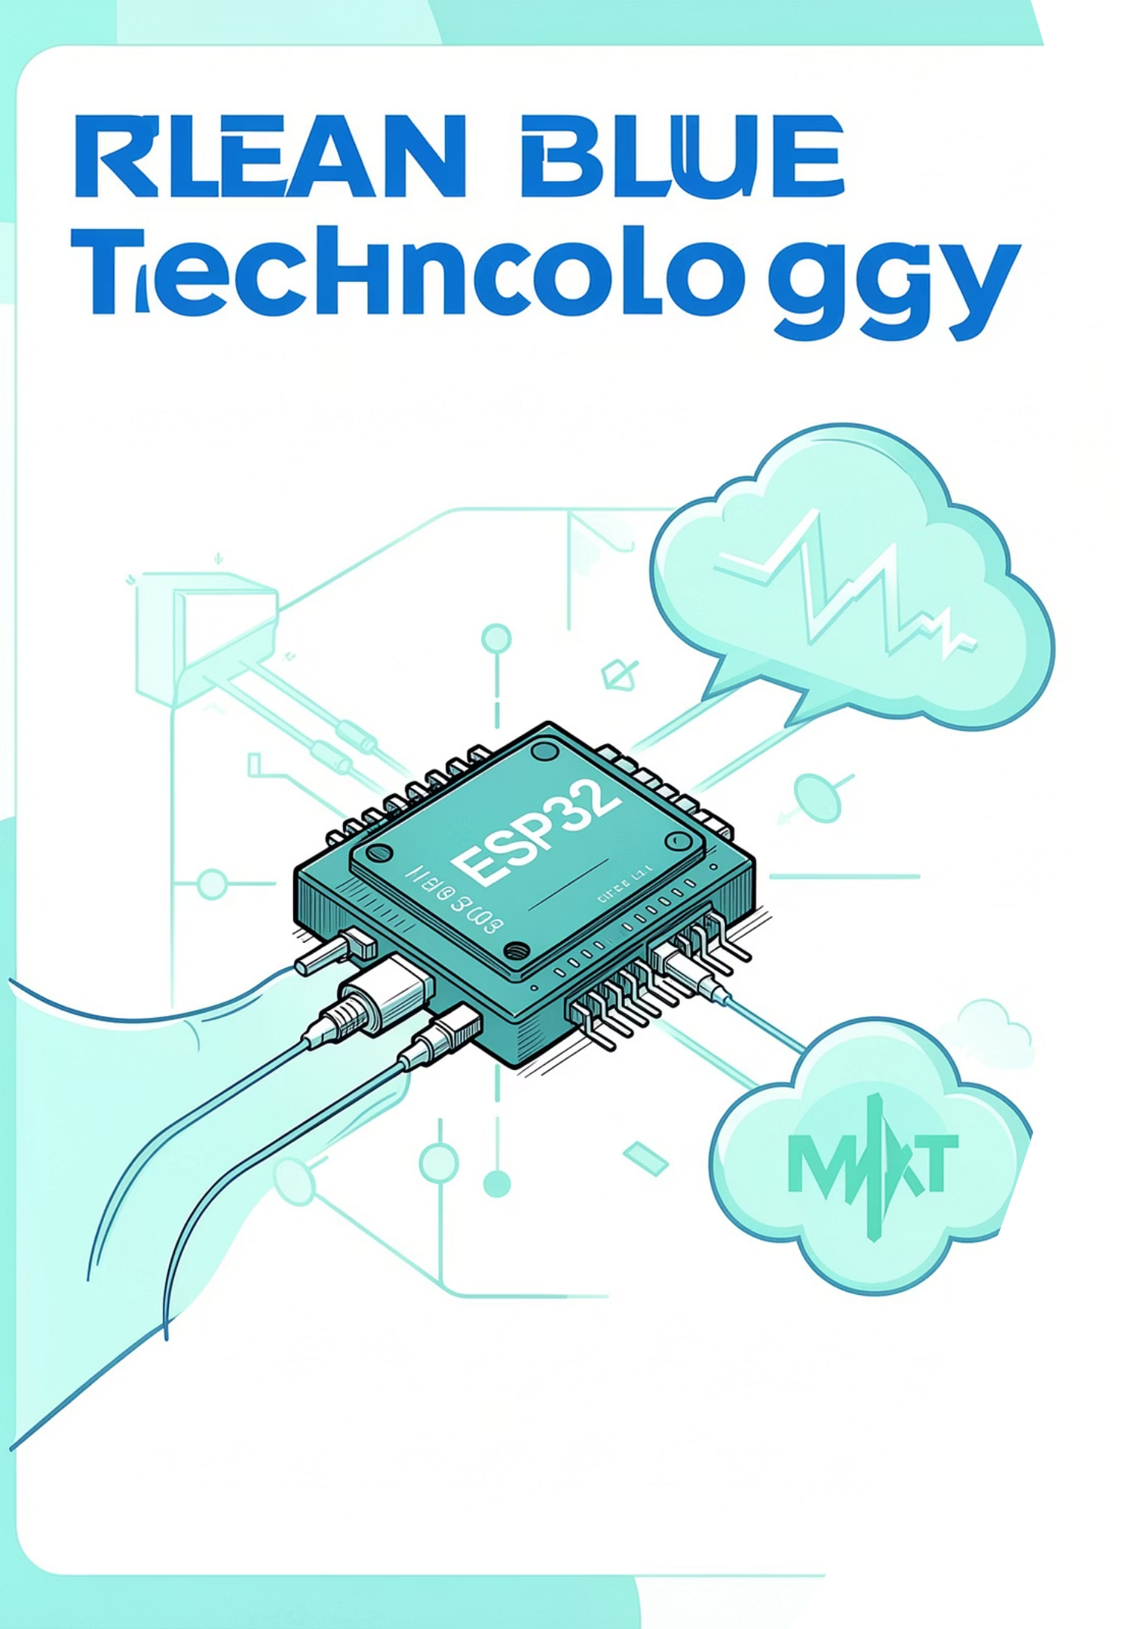
MQTT Protocol in IoT
IoT-Based Smart Medicine Reminder and Pill Monitoring System
TEAM MEMBERS :
Rubadharshini S
Puthiyaraj P
Sangili Murugan M

Slide 2


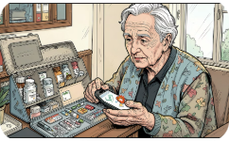
Introduction
What is IoT?
Importance in Healthcare
Need for Smart Reminders
Network of sensors and devices exchanging data to enable remote monitoring and automation.
Enables continuous monitoring, timely interventions, and better patient outcomes.
Reduce missed doses, support caregivers remotely, and maintain medication adherence records.

Slide 3
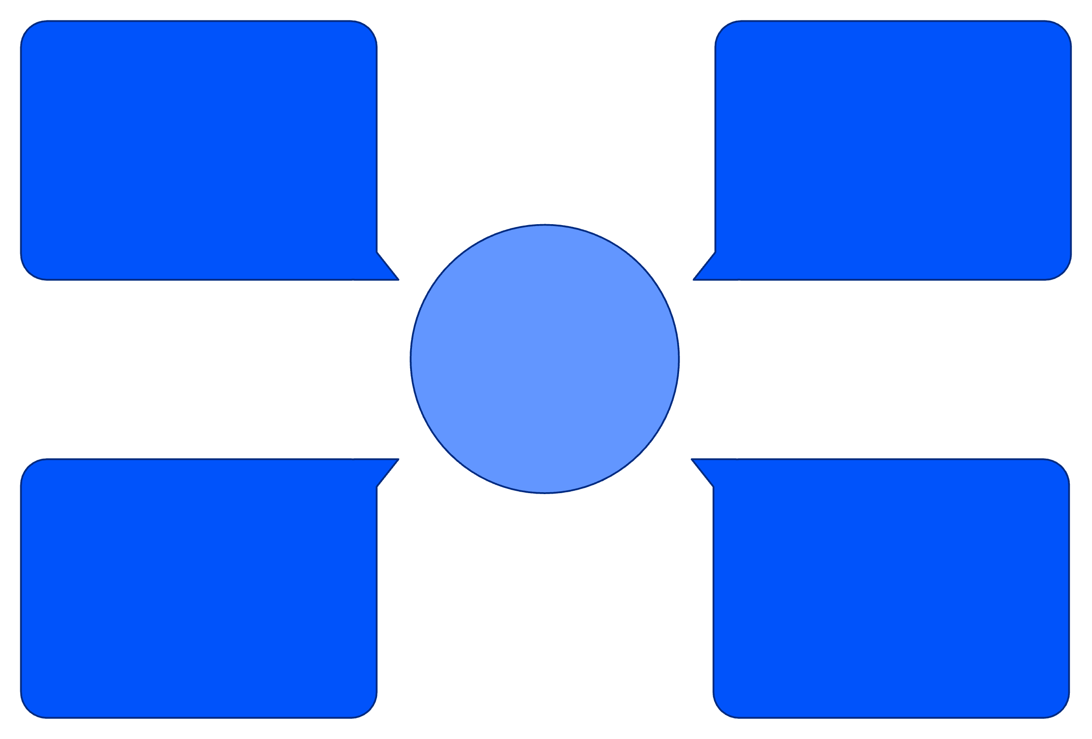
MQTT Protocol — At a Glance
Full Form
What is MQTT?
Publish–Subscribe Model
Message Queuing Telemetry Transport
Lightweight publish–subscribe protocol optimized for constrained devices and unreliable networks.
Publishers send messages to topics; subscribers receive messages they subscribe to — decoupled communication.
MQTT Broker
Advantages
Central message router (e.g., Mosquitto, Cloud MQTT) handling session state, QoS, and topic routing.
Low bandwidth, small packet overhead, low power consumption, QoS levels for reliability.
Caregiver Dashboard
ESP32 (publisher)
MQTT Simple Architecture
Mobile App (subscriber)
MQTT Broker (cloud)
Diagram: ESP32 devices publish status to broker; apps and caregiver dashboards subscribe to relevant topics for real-time updates.

Slide 4
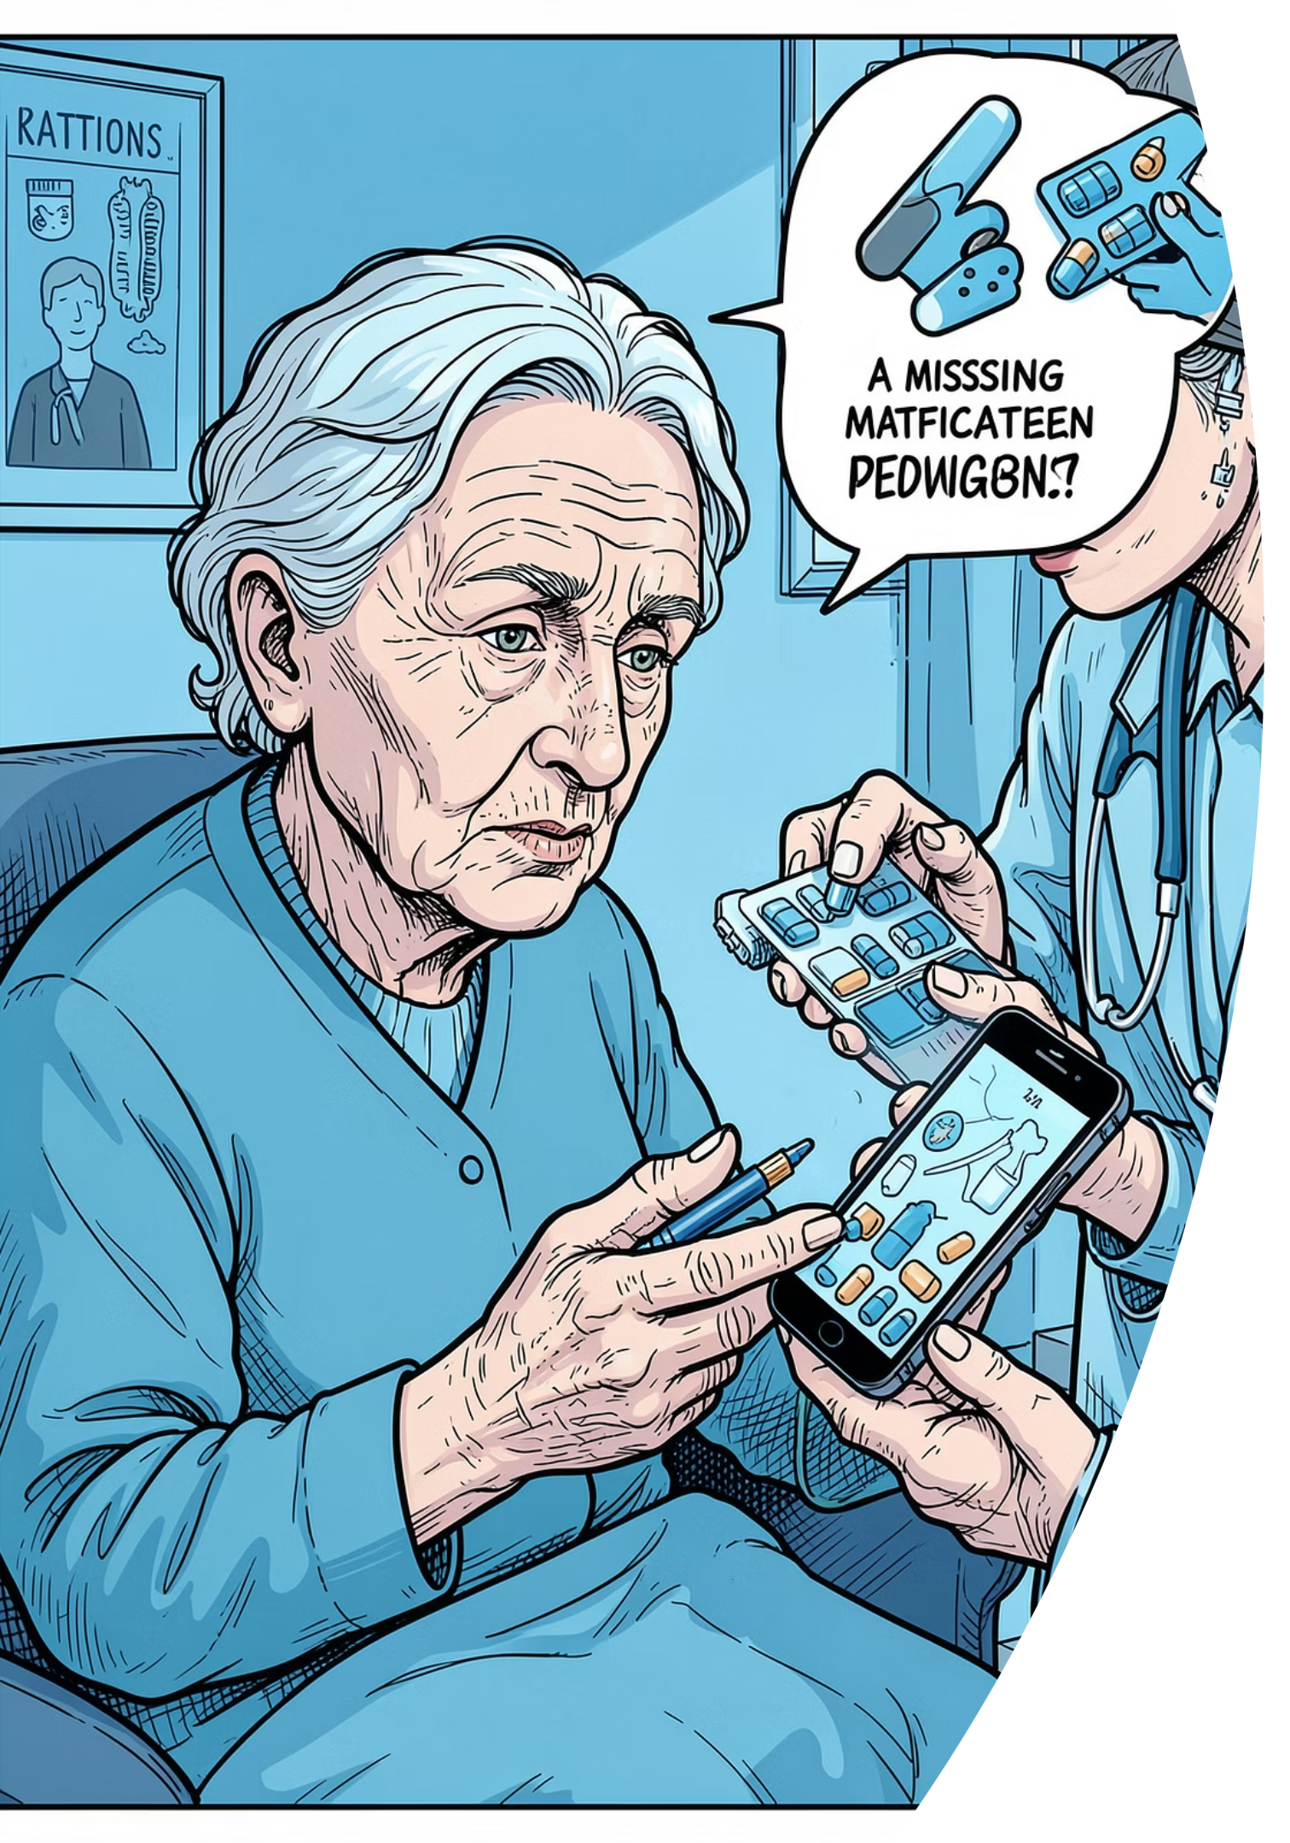
Problem Statement & Project Objectives
Problem Statement
Objectives
Patients often forget scheduled medicines.
Caregivers lack remote visibility into adherence.
Missed doses can worsen health outcomes.
Provide timely, reliable medicine reminders.
Monitor and record pill intake events.
Send real-time notifications to family/caregivers.
Persist medication logs in cloud for audits and analysis.

Slide 5
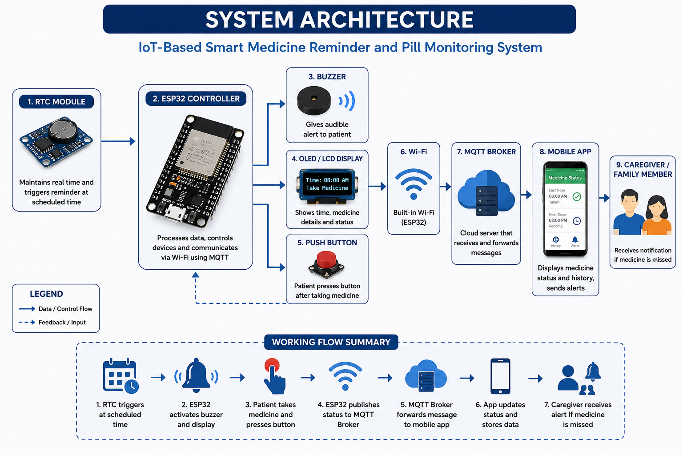
Notes on data flow: • RTC triggers reminder at scheduled time. • ESP32 activates buzzer and display. • Patient presses push button to confirm. • ESP32 publishes medicine status via MQTT. • Broker forwards message to subscribed mobile app. • Caregiver receives alert for missed doses.

Slide 6
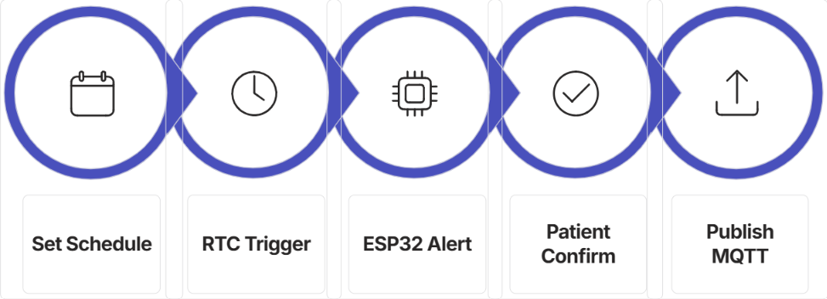
Working Principle — Step by Step
Step-by-step summary: 1. Medicine schedule configured on mobile/cloud. 2. RTC triggers ESP32 at scheduled time. 3. Buzzer and display alert the patient. 4. Patient confirms intake via push button. 5. ESP32 publishes a JSON status message to MQTT topic (e.g., home/patientX/medicine). 6. Mobile app and caregiver dashboards receive the update. 7. If no confirmation within timeout, system issues caregiver alert and logs a missed dose.

Slide 7
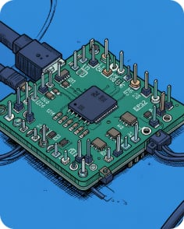
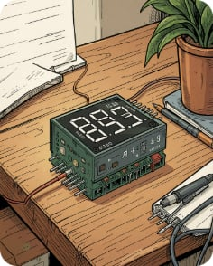

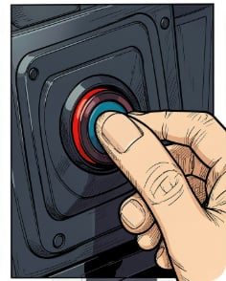
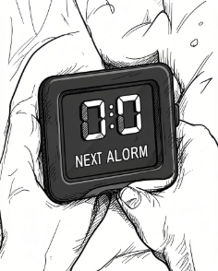
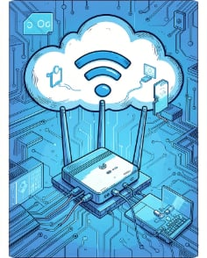
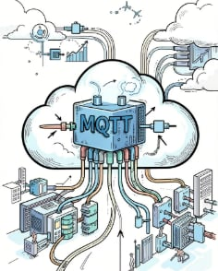
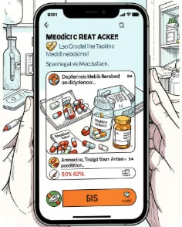
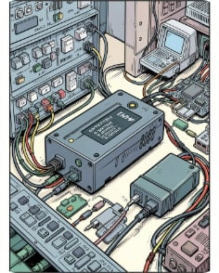
Components Used
ESP32
RTC Module
Buzzer
Push Button
Wi‑Fi enabled microcontroller — handles scheduling, sensor input, and MQTT communication.
Maintains accurate time for schedule triggers even after power cycles.
Local audible reminder for the patient.
Patient confirms medication intake; input read by ESP32.
OLED / LCD Display
Wi‑Fi
MQTT Broker
Mobile App
Network link between ESP32 and MQTT broker (local or cloud).
Message hub managing topics, sessions, and QoS.
Receives updates, displays logs, and alerts caregivers.
Shows schedule, reminders, and confirmation prompts.
Power Supply
Reliable power with battery backup to ensure reminders remain active.

Slide 8
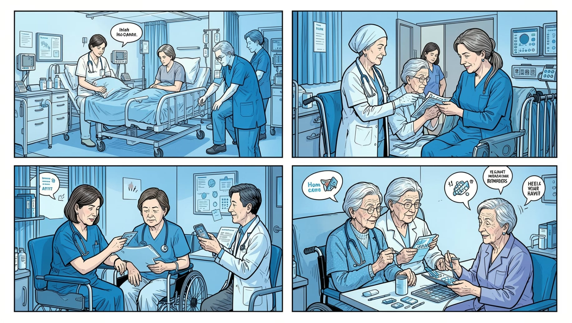
Advantages & Applications
Applications
Low Cost
Hospitals — inpatient medication adherence support
Home Healthcare — assist patients living independently
Elderly Care — reduce caregiver burden and risk
Clinics — outpatient medication monitoring
Longitudinal Patient Monitoring — build adherence datasets
Affordable hardware and open protocols.
Real-Time Monitoring
Immediate visibility into adherence events.
Reliable Communication
MQTT with QoS ensures message delivery.
Easy to Use
Simple UI and single‑button confirmation for patients.
Remote Notifications
Caregivers receive alerts for missed doses.

Slide 9
Future Enhancements
AI-Based Scheduling
Voice Assistant Integration
Smartwatch Notifications
Adaptive reminders that learn patient behavior and optimize times to maximize adherence.
Hands-free confirmations and medication instructions via smart speakers or phone assistants.
Haptic reminders and one-touch confirmations from wearables.
Cloud Analytics Dashboard
Camera-Based Pill Detection
Aggregate adherence trends, generate reports for clinicians, and support research.
Computer vision to verify pill presence and ingestion when required.

Slide 10

Conclusion & Thank You
MQTT provides a lightweight, reliable backbone for IoT healthcare systems. Combined with ESP32-based devices and cloud brokers, the proposed Smart Medicine Reminder system improves medication adherence, enables remote caregiver oversight, and generates adherence records for clinical use.

